Slide 1
AI Applications in Healthcare: Wrist Fracture Detection Using YOLO-v9
Dhashwanth Bharathi 21BCE1553
Maddala Sai Riship 21BCE1600
Suseel Mathusoothanan 21BCE1645

Slide 2
ABSTRACT
Wrist fractures are among the most frequently occurring injuries and require immediate and accurate diagnosis to avoid potential long-term complications. This study introduces an innovative approach to wrist fracture detection by employing YOLOv9, a cutting-edge object detection algorithm that leverages advanced deep learning techniques. Our approach aims to facilitate the automatic identification of wrist fractures in X-ray images, achieving both high accuracy and efficiency. Through extensive training of the YOLOv9 model on a large and diverse dataset of labeled X-ray images, we observe substantial improvements in both the accuracy and speed of fracture detection when compared to conventional methods.
The experimental results from our study are encouraging, as they demonstrate that this method outperforms traditional diagnostic techniques. The proposed approach holds considerable promise in aiding radiologists with wrist fracture diagnosis, providing faster and more reliable assessments. This advancement has the potential not only to improve patient outcomes by ensuring timely and accurate treatment but also to contribute to reducing overall healthcare costs by streamlining the diagnostic process and minimizing the likelihood of misdiagnosis or delayed care.

Slide 3
MOTIVATION
Wrist fractures are one of the most common orthopedic injuries, often resulting from falls, accidents, or sports-related incidents. Quick and accurate diagnosis is critical to prevent long-term complications, such as reduced mobility, chronic pain, or improper healing. However, traditional diagnostic methods heavily rely on manual assessment, which can be time-consuming and susceptible to human error, particularly in high-stress environments like emergency departments.
The motivation behind this project is to harness the power of deep learning to improve the speed, accuracy, and reliability of wrist fracture detection. By utilizing YOLOv9, a state-of-the-art object detection algorithm, our project aims to automate the detection process in X-ray images, providing radiologists with an effective tool to assist in the diagnosis of fractures. This approach not only reduces the likelihood of misdiagnosis but also contributes to faster patient recovery and reduces the burden on healthcare systems by minimizing diagnostic time and associated costs.

Slide 4
OBJECTIVES
Leverage YOLOv9’s advanced object detection capabilities to accurately identify wrist fractures in X-ray images, aiming for high precision and minimal false positives and false negatives.
Implement a deep learning model that significantly reduces the time required for wrist fracture detection compared to traditional manual methods, thereby improving the speed of diagnosis and treatment initiation.
Train the YOLOv9 model on a large and diverse dataset of annotated X-ray images to ensure the model is resilient to variations in image quality, patient demographics, and fracture types.
Assess the accuracy, sensitivity, and specificity of the YOLOv9-based approach and compare its performance with conventional diagnostic techniques, establishing its viability and potential for practical deployment.
Demonstrate how AI-assisted fracture detection can contribute to lowering healthcare costs by optimizing diagnostic workflows, reducing the need for secondary opinions, and minimizing the risk of misdiagnosis.
Highlight the potential of deep learning in medical imaging for applications beyond wrist fracture detection, inspiring further research and innovation in AI-driven diagnostic tools across healthcare.

Slide 5
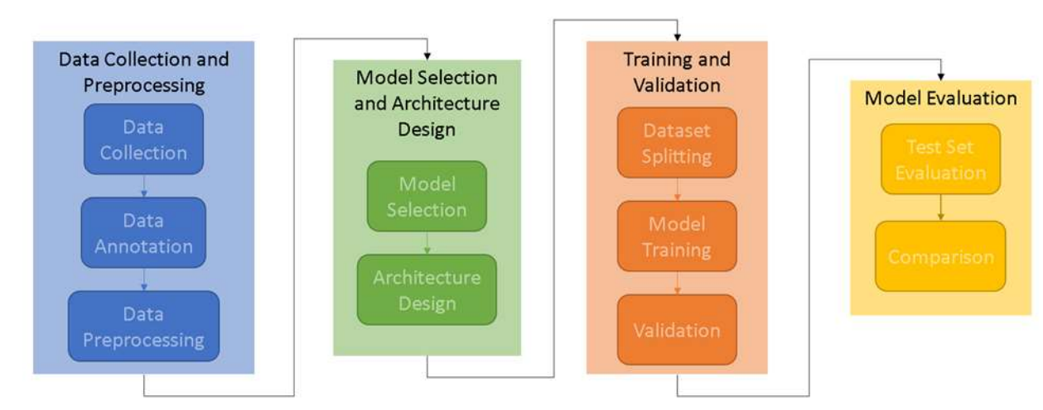
PROPOSED SYSTEM

Slide 6
PROPOSED SYSTEM - COntinued
Data Collection: Compile a diverse dataset of wrist X-ray images sourced from medical archives, hospitals, and clinics. This dataset should include various fracture types, severities, and patient demographics to ensure the model is robust and generalizable.
Data Annotation: Mark and outline the fracture regions within each X-ray image to prepare the data for training. This annotated data enables the model to learn to accurately detect fracture locations during training.
Data Preprocessing: Enhance the quality of the X-ray images by performing preprocessing steps such as resizing to a consistent resolution, applying contrast adjustments to improve visibility, and normalizing pixel values for uniformity across the dataset.
Model Selection: Select YOLOv9 as the primary deep learning architecture due to its high accuracy and real-time performance, which is well-suited for object detection tasks like fracture identification.
Architecture Customization: Tailor the selected YOLOv9 architecture specifically for wrist fracture detection by adjusting network parameters, input sizes, and output layers to optimize detection accuracy for X-ray images.
Dataset Splitting: Divide the dataset into training, validation, and test sets. The training set is for model learning, the validation set is for tuning hyperparameters and monitoring performance, and the test set is for evaluating final performance.
Model Training: Train the customized YOLOv9 model on the training set. The model learns to detect fractures by adjusting its internal parameters based on the annotated X-ray images and their fracture locations.
Test Set Evaluation: Test the trained model on the unseen test set to evaluate its final accuracy and measure metrics such as mean Average Precision (mAP), Intersection over Union (IoU), and overall accuracy for precise fracture detection.

Slide 7
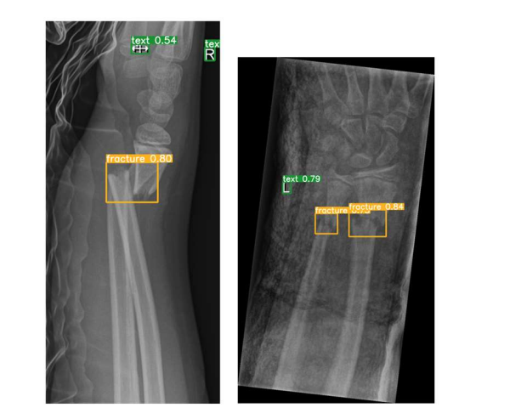
RESULTS

Slide 8
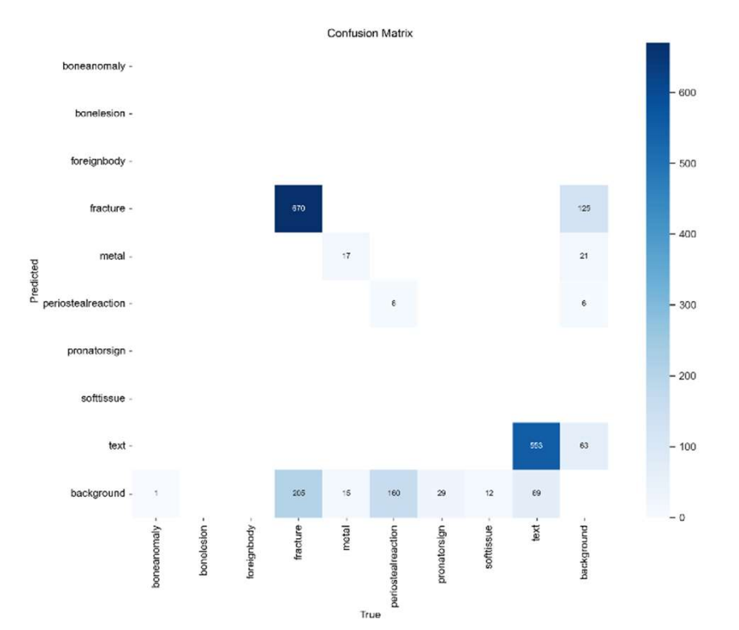
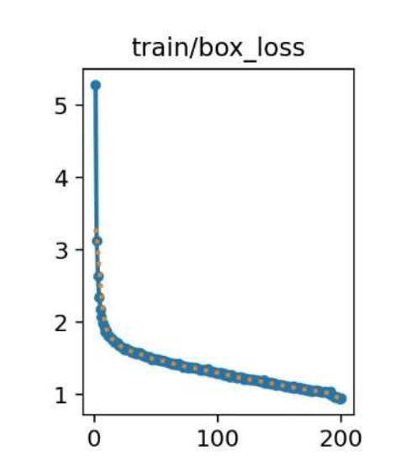
Confusion Matrix and Loss Curve

Slide 9
REFERENCES
[1] Schork, N. J. (2019). Artificial intelligence and personalized medicine. Precision medicine in Cancer therapy, 265-283.
[2] Chavali, D., Dhiman, V. K., & Katari, S. C. AI-Powered Virtual Health Assistants: Transforming Patient Engagement Through Virtual Nursing.
[3] Hamburg, M. A., & Collins, F. S. (2010). The path to personalized medicine. New England Journal of Medicine, 363(4), 301-304.
[4] Shaban-Nejad, A., Michalowski, M., & Bianco, S. (Eds.). (2023). Artificial Intelligence for Personalized Medicine: Promoting Healthy Living and Longevity (Vol. 1106). Springer Nature.
[5] Rawat, B., Joshi, Y., & Kumar, A. (2023, August). AI in Healthcare: Opportunities and Challenges for Personalized Medicine and Disease Diagnosis. In 2023 5th International Conference on Inventive Research in Computing Applications (ICIRCA) (pp. 374-379). IEEE.
[6] Ghebrehiwet, I., Zaki, N., Damseh, R., & Mohamad, M. S. (2024). Revolutionizing Personalized Medicine with Generative AI: A Systematic Review.
[7] Parekh, A. D. E., Shaikh, O. A., Manan, S., & Al Hasibuzzaman, M. (2023). Artificial intelligence (AI) in personalized medicine: AI- generated personalized therapy regimens based on genetic and medical history. Annals of Medicine and Surgery, 85(11), 5831-5833.
[8] George, A. H., & George, A. S. (2023). From Pulse to Prescription: Exploring the Rise of AI in Medicine and Its Implications. Partners Universal International Innovation Journal, 1(6), 38-54.
[9] Rane, N., Choudhary, S., & Rane, J. (2023). Towards Autonomous Healthcare: Integrating Artificial Intelligence (AI) for Personalized Medicine and Disease Prediction. Available at SSRN 4637894.
[10] Patrinos, G. P., Sarhangi, N., Sarrami, B., Khodayari, N., Larijani, B., & Hasanzad, M. (2023). Using ChatGPT to predict the future of personalized medicine. The Pharmacogenomics Journal, 23(6), 178- 184.

